Slide 1
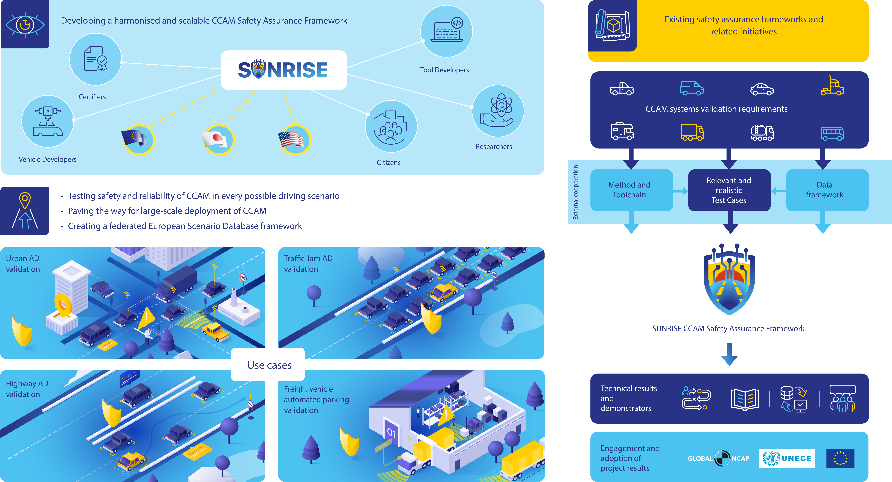
Contacts:
Name, company, email (optional)
General email: info@ccam-sunrise-project.eu
Project Coordinator: Stefan de Vries (IDIADA)
stefan.devries@idiada.com

